Slide 1
Fiscal Year 2023 Budget Hearing
South Carolina Department Of Revenue
Director Hartley Powell

Slide 2
Agenda
Attendees
Organizational Chart
Performance
Budget & Proviso Request Summary
Fiscal Management
Ensure a Secure Environment
Carry Forward Information
FTE Breakdown

Slide 3
With You Today
W. Hartley Powell Director
(803) 898-9971
Hartley.Powell@dor.sc.gov
Meredith Cleland Deputy Director
Government Services
(803) 898-5402
Meredith.Cleland@dor.sc.gov

Slide 4
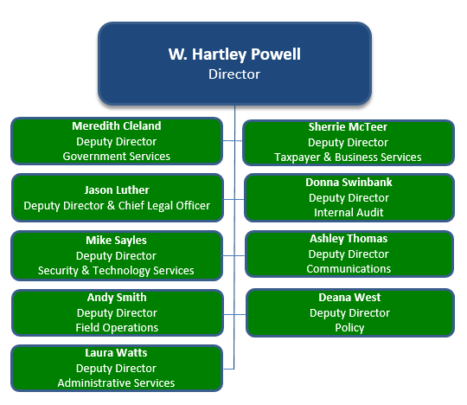
SCDOR Organizational Chart

Slide 5
SCDOR Performance
6%
Other
Taxes
6%
Corporate Tax
95%
General Fund Revenue
Collected by SCDOR
36%
Sales and Use Tax
$10.5B
FY21 General Fund Revenue
Collected by SCDOR
$4.9B
FY21 SCDOR Collections
Allocated to Local & State Entities
52%
Income
Tax

Slide 6
Budget & Proviso Request Summary
FY23 General Fund Appropriations Request
FY23 Non-Recurring Request
FY23 Capital Request
FY23 Proviso Changes
FY23 Other Funds Authority Request -$11M
No
No
No
No
Yes

Slide 7
Fiscal Management
Managed the operation of SCDOR within spending authority
Increased savings through effective fiscal management
Current savings exceed spending authority by $11M
Important to use this money to enhance taxpayer security
No additional funding requested

Slide 8
Ensure a Secure Environment
Maintaining a secure environment is vital to protecting taxpayer information.
Staying ahead of cyber-security threats is a constant challenge, and the costs are increasing.
SCDOR must transition to a cloud-based platform, which is the "next generation" of security standards.
1st phase – establish a cloud-based security platform
2nd phase – move computer systems from state data center into the secure cloud
3rd phase – transfer all tax processing systems from the state data center into the secure cloud
The Department of Administration has approved SCDOR's transition to a cloud-based system, which will take several years.

Slide 9
Carry Forward Information
 | FY21 Revenues | Spending Authority | Carryforward
Other Funds Revenues | $37,570,868 | $34,177,093 | $3,393,775
Other Funds Carryforward | $7,738,332 |  | $7,738,332
Totals | $45,309,200 | $34,177,093 | $11,132,107

Slide 10
FTE Breakdown
FTE Categories | Total
Filled FTEs | 642
Vacant FTEs | 162
Total FTEs | 804

Slide 11
Need Help?
More Questions?
Meredith Cleland, Deputy Director Government Services
South Carolina Department of Revenue
P.O. Box 125
Columbia, SC 29214
dor.sc.gov

